Slide 1

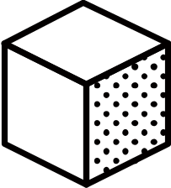
학교명, 출품자 성명
Panel title
Sub title
body
Panel title
Sub title
body
Body area
Sub title
Photo
Photo
Title
Title
Sub title
body

Slide 2

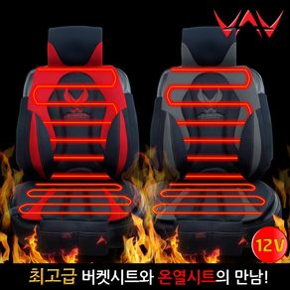
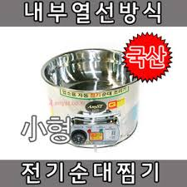
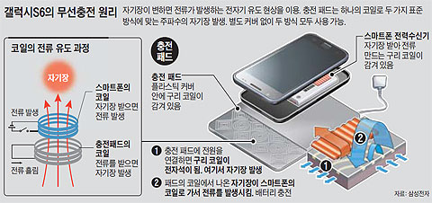
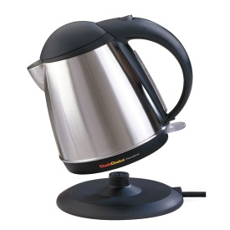
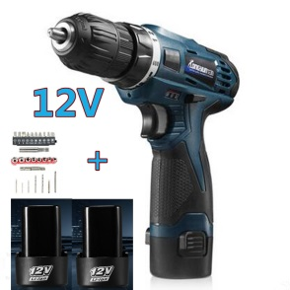
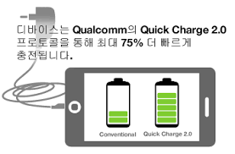
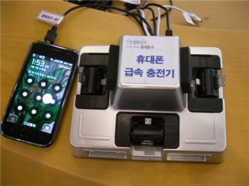
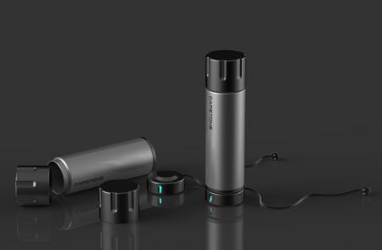
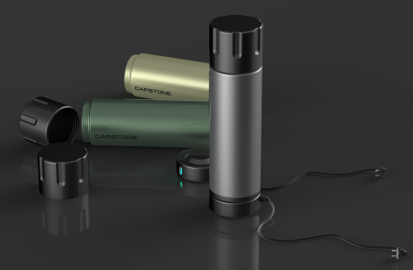
Introduction
In these days, so many people enjoy tumblers for their coffee and teas.
But ordinary tumblers has limitations for maintaining hot temperature.
Most customers want hot coffee or tea during their enjoying time.
So, we suggest wireless charging technic based low heating tumbler.
Panel title
Technical Feasibility
Which technology can solve the problem?
Heating by imbedded current line for the low temperature boiling
Wireless design and wireless charging battery system for the convenience
Rapid charging system for the time saving
Use Existing Technology
Electric heating by imbedded line
Wireless charging system
Body area
Wireless connecting
Rapid charging
Our Product Design
Low Heatable Tumbler 1
Low Heatable Tumbler 2

